Slide 1
Smart QR
TEAM 1:
Murali Krishna Sai Chukka & 05
Venkatesh Ponduri & 23
Apoorva Geetanjali Avadhanula & 01
Hima Bindu Vatsavayi & 28

Slide 2
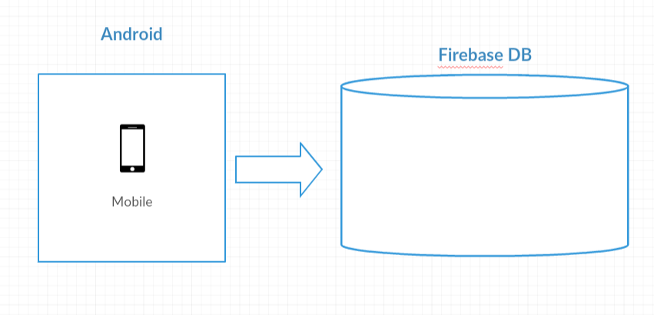
Architecture Diagram

Slide 3
Modules list
Login.
Home.
User details.
Scan & Generate QR.
OCR.

Slide 4
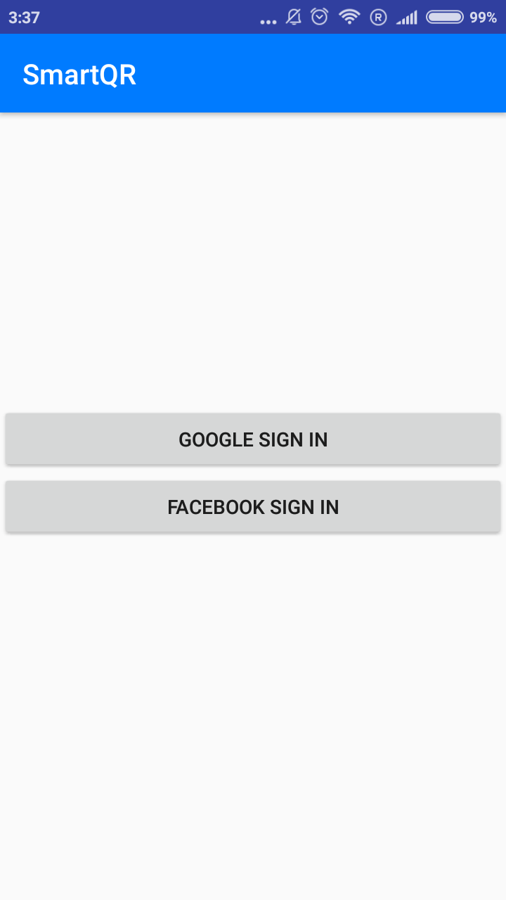
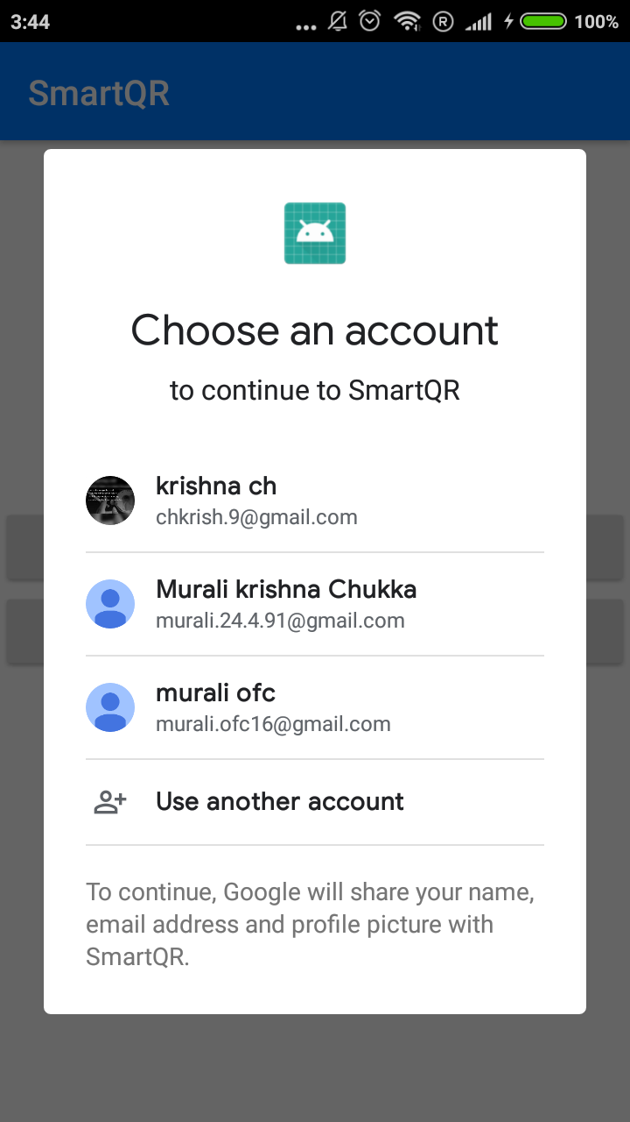
Login Page

Slide 5
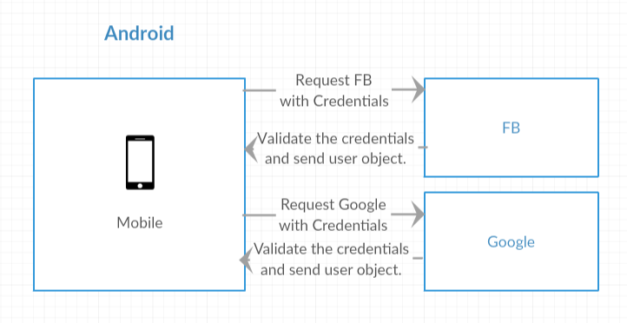
Login flow

Slide 6
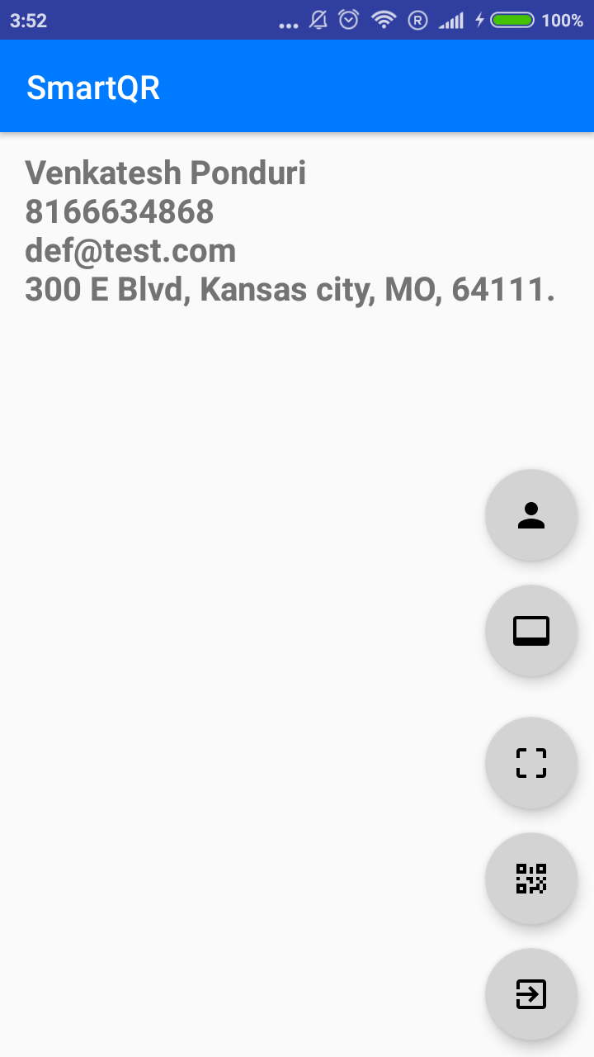
Home Page

Slide 7
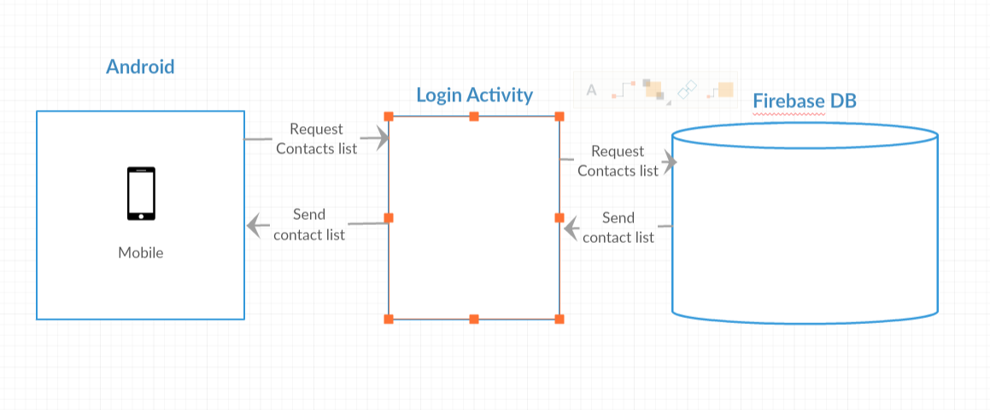
Home page flow

Slide 8
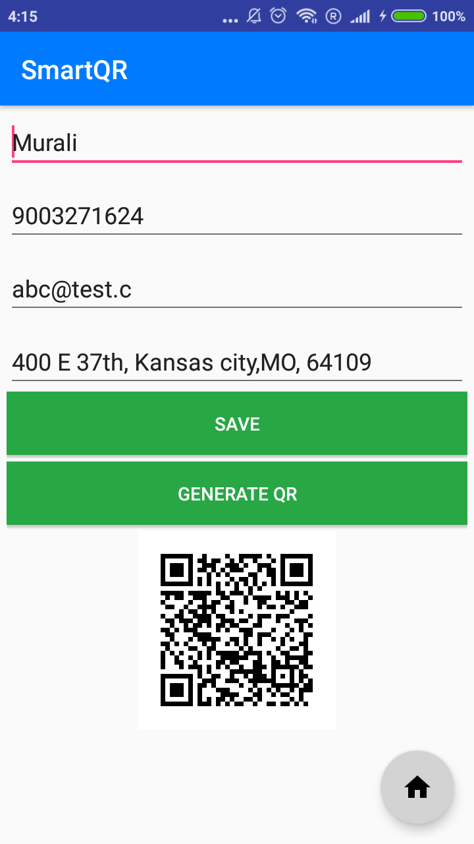
User details page

Slide 9
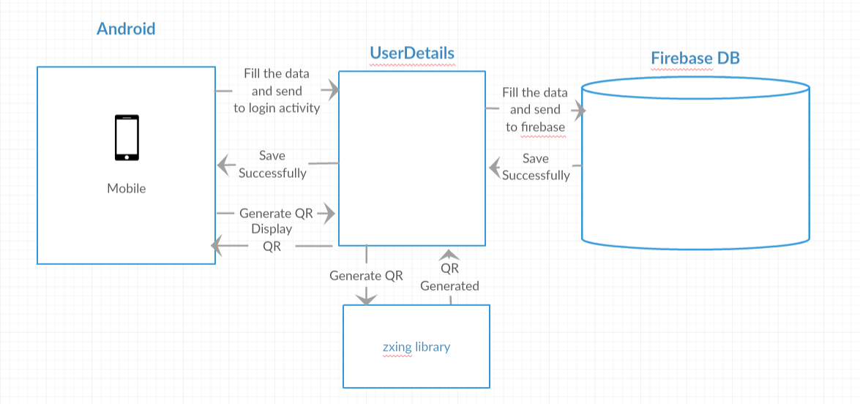
User details flow

Slide 10
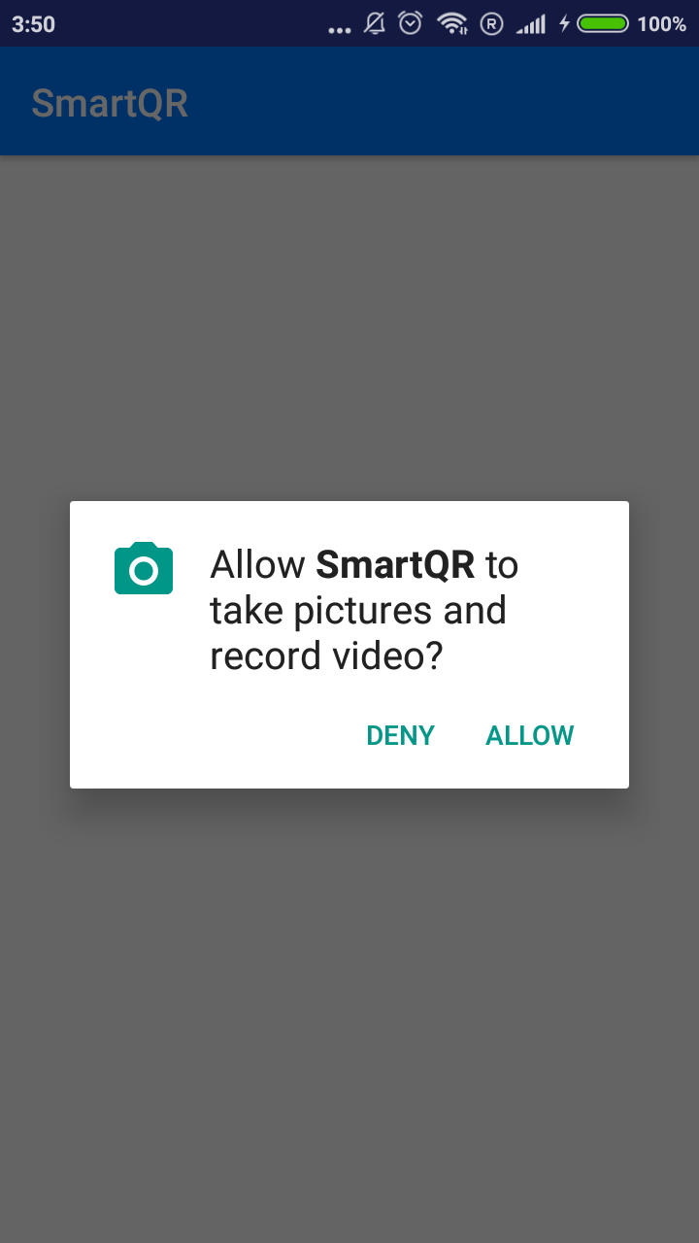
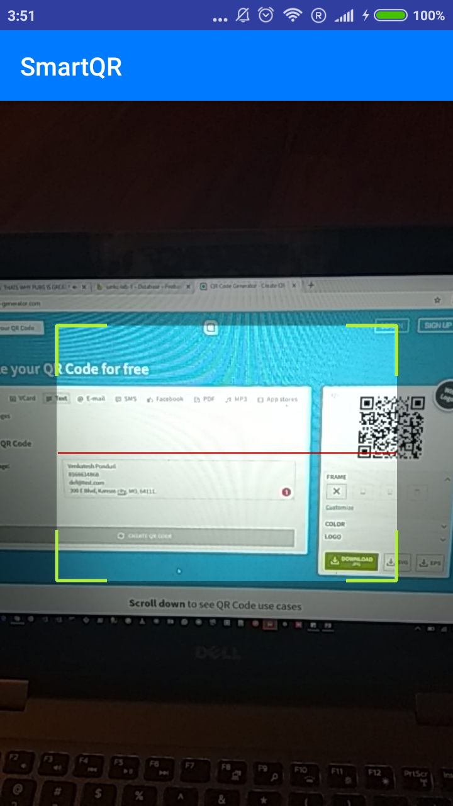
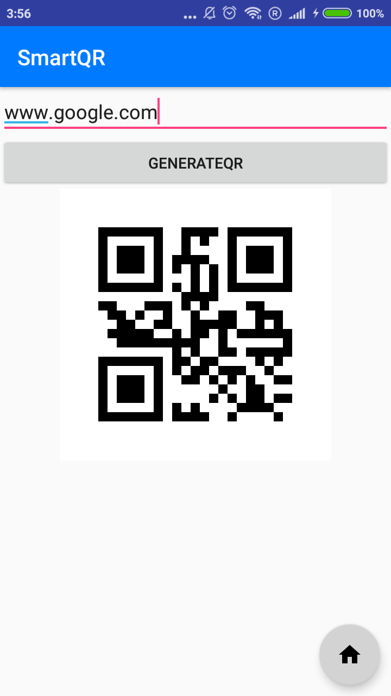
Scan & Generate QR.

Slide 11
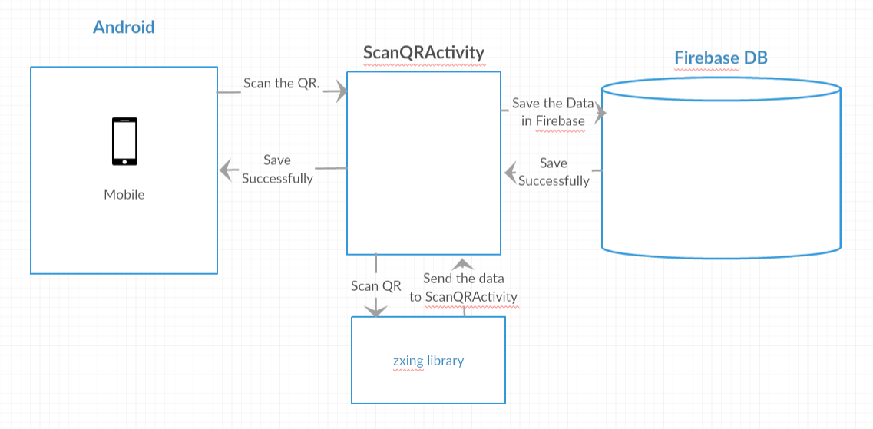
Scan flow

Slide 12
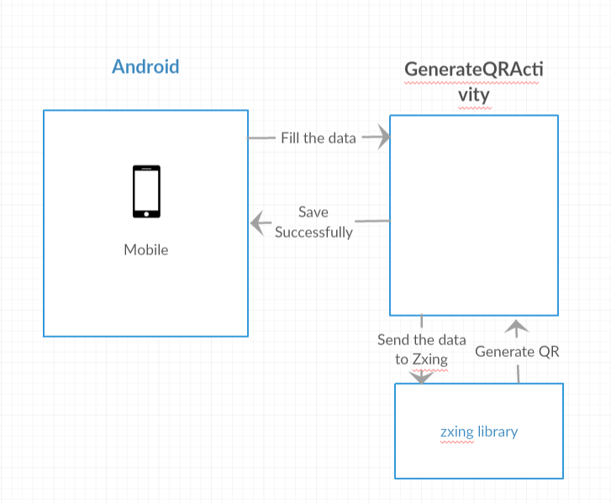
Generate QR

Slide 13
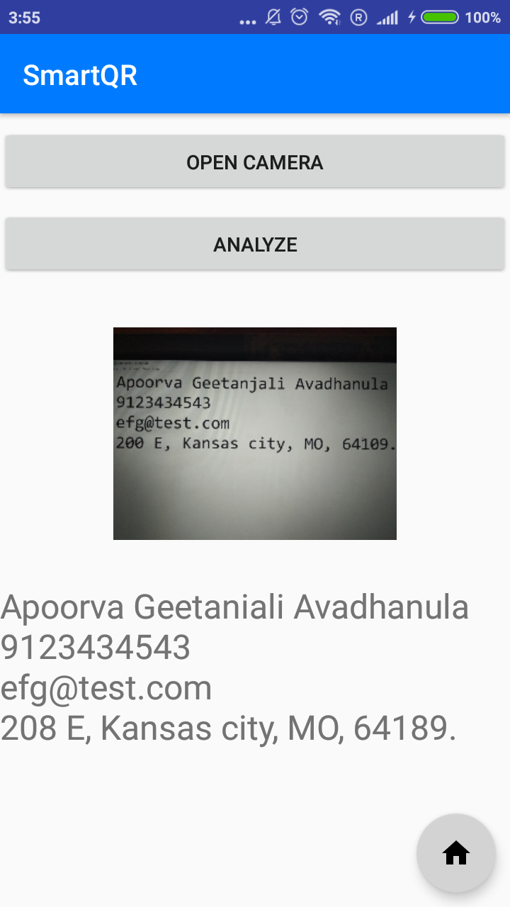
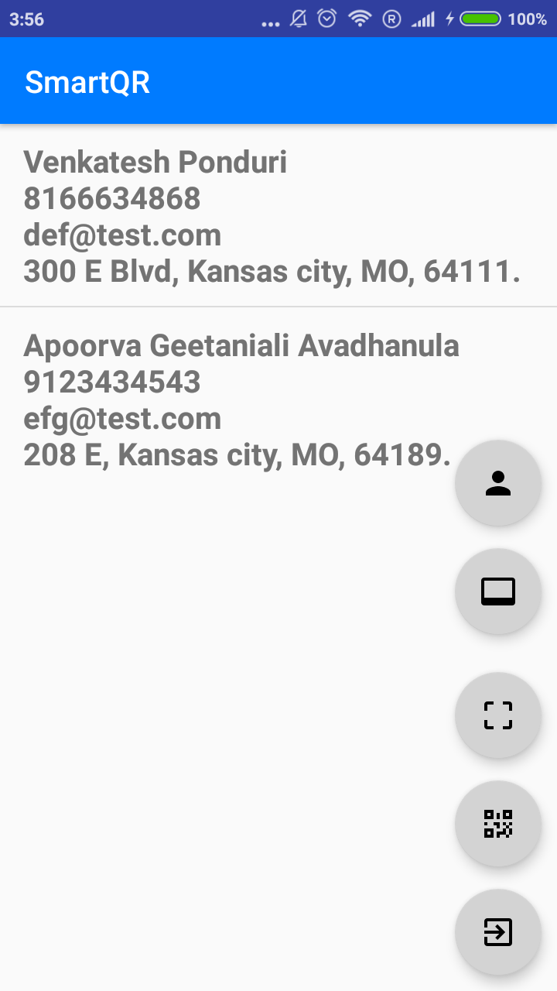
Scan card (OCR)

Slide 14
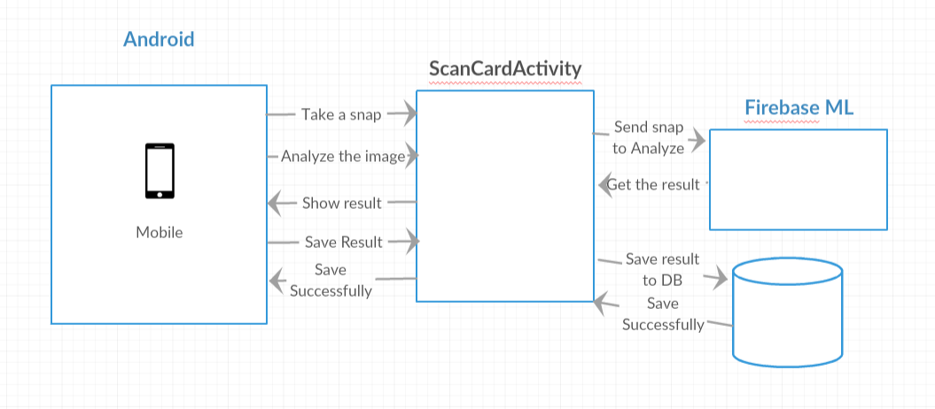
Scan card flow

Slide 15
Questions ?

Slide 16
Thank you

